Slide 1
Linear Algebra & Statistics EMTH1019 Vectors – Week 5

Slide 3
Vectors
Vector Basics & Notation
Dot Product
Scalar & Vector Projections
Direction Cosines

Slide 4
Resources for Linear ALgebra
Slides
Lecture Notes
Lecture problems on first few pages of notes
Tutorial problems
News Forum

Slide 5
Resources & Homework
The lecture notes are much more detailed than this PowerPoint
You should be able to do all the exercises on page 2 and 3 of this weeks lecture notes
The Khan Academy has some wonderful resources
Link to Khan Academy - Vectors

Slide 6
Important
Everything we do with vectors relies on you learning these basic skills.
Make a vector from 2 points
Determine the magnitude (length) of a vector
Add and subtract vectors
2 ways of multiplying vectors
Scalar product – also known as Dot Product – produces a scalar
Vector Product – also known as Cross Product – produces another vector
For instance:
To find the angle between 2 vectors you need to be able to do 2 & 4a.
To find how much of a vector lies in a different direction requires 2 & 4a.
To find an R³ vector orthogonal to 2 other vectors requires 4b & 2.

Slide 7
What is a vector?
Latin origin
From the Latin vector, “one who carries or conveys” or “one who rides”
Physics
A quantity that has both direction and magnitude
Mathematics
A matrix with one row or one column
Biology
An organism, such as a mosquito, that transmits a disease of parasite from one living thing to another
Aviation
A course taken by an aircraft

Slide 8
Vectors & Scalars
In Engineering
Scalars only have magnitude (no direction)
7 kg, 14 years, 21 kmh, 28 metres
Vectors have both magnitude and direction
11 km due west, 9.8 m/s² towards the earth, 12 miles north by north west

Slide 9
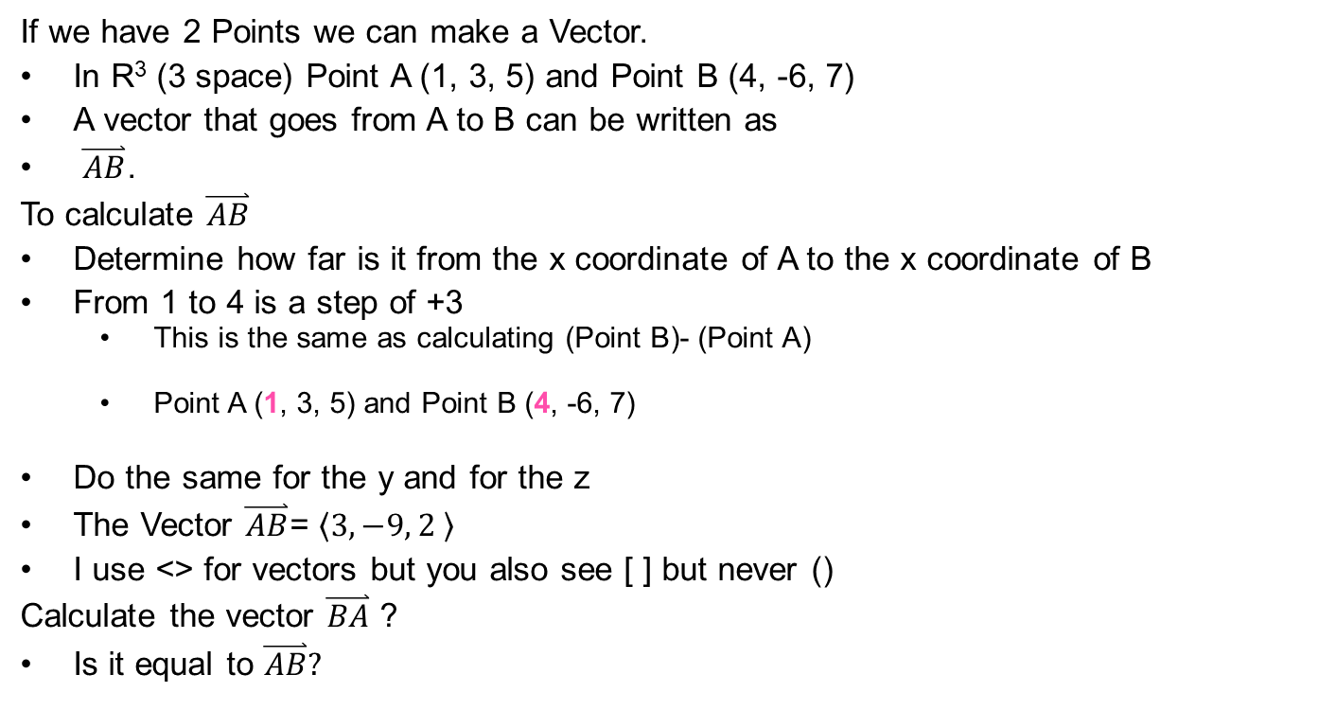
Vector representation
If we have 2 Points we can make a Vector.
In R³ (3 space) Point A (1, 3, 5) and Point B (4, -6, 7)
A vector that goes from A to B can be written as
$\overset{⃑}{AB}$.
To calculate $\overset{⃑}{AB}$
Determine how far is it from the x coordinate of A to the x coordinate of B
From 1 to 4 is a step of +3
This is the same as calculating (Point B)- (Point A)
Point A (1, 3, 5) and Point B (4, -6, 7)
Do the same for the y and for the z
The Vector $\overset{⃑}{AB}$= $\left\langle 3, −9, 2 \right\rangle$
I use <> for vectors but you also see [ ] but never ()
Calculate the vector $\overset{⃑}{BA}$ ?
Is it equal to $\overset{⃑}{AB}?$

Slide 10
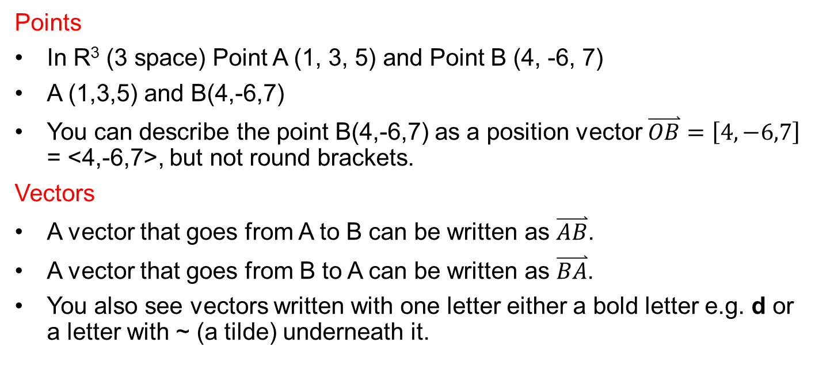
Point and vector notation
Points
In R³ (3 space) Point A (1, 3, 5) and Point B (4, -6, 7)
A (1,3,5) and B(4,-6,7)
You can describe the point B(4,-6,7) as a position vector $\overset{⃑}{OB}=\left[4,−6,7\right]$ = <4,-6,7>, but not round brackets.
Vectors
A vector that goes from A to B can be written as $\overset{⃑}{AB}$.
A vector that goes from B to A can be written as $\overset{⃑}{BA}$.
You also see vectors written with one letter either a bold letter e.g. d or a letter with ~ (a tilde) underneath it.

Slide 11
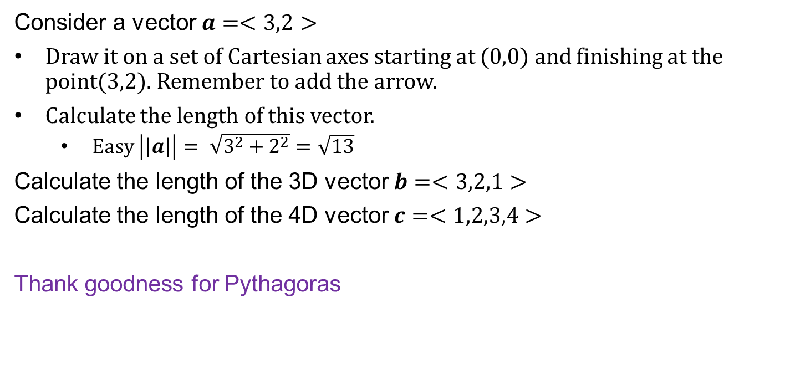
Magnitude of a Vector
Consider a vector $a=<3,2>$
Draw it on a set of Cartesian axes starting at (0,0) and finishing at the point(3,2). Remember to add the arrow.
Calculate the length of this vector.
Easy $\left|\left|a\right|\right|= \sqrt{3^{2}+2^{2}}=\sqrt{13}$
Calculate the length of the 3D vector $b=<3,2,1>$
Calculate the length of the 4D vector $c=<1,2,3,4>$
Thank goodness for Pythagoras

Slide 12
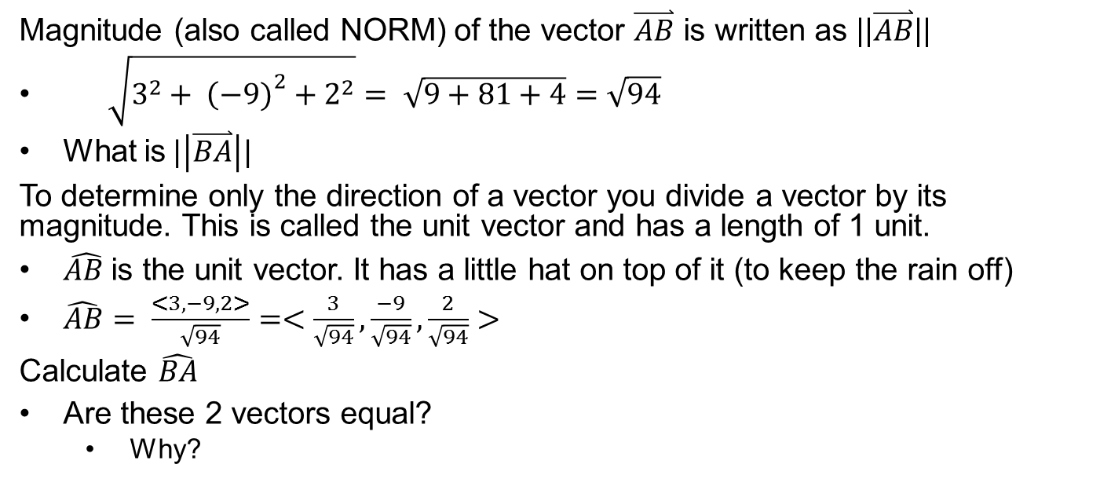
Are the Vectors equal?
If $\overset{⃑}{AB}$= $\overset{⃑}{BA}$ the both the magnitude and the direction must be equal
Magnitude (also called NORM) of the vector $\overset{⃑}{AB}$ is written as ||$\overset{⃑}{AB}$||
$\sqrt{3^{2}+ {\left(−9)\right.}^{2}+2^{2}}= \sqrt{9+81+4}=\sqrt{94}$
What is$|\left|\overset{⃑}{BA}\right||$
To determine only the direction of a vector you divide a vector by its magnitude. This is called the unit vector and has a length of 1 unit.
$\hat{AB }$is the unit vector. It has a little hat on top of it (to keep the rain off)
$\hat{AB}= \frac{<3,−9,2>}{\sqrt{94}}=<\frac{3}{\sqrt{94}},\frac{−9}{\sqrt{94}},\frac{2}{\sqrt{94}}>$
Calculate $\hat{BA}$
Are these 2 vectors equal?
Why?

Slide 13
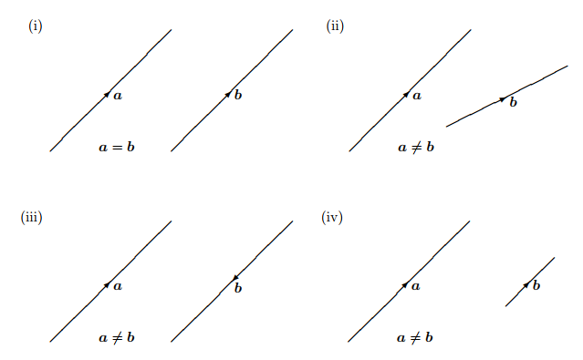

Slide 14
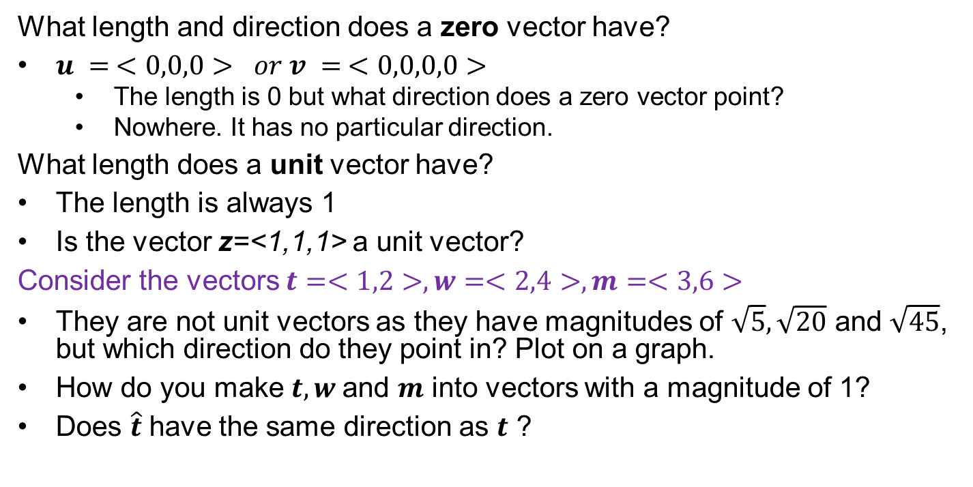
Zero & Unit Vectors
What length and direction does a zero vector have?
$u = <0,0,0> or v = <0,0,0,0>$
The length is 0 but what direction does a zero vector point?
Nowhere. It has no particular direction.
What length does a unit vector have?
The length is always 1
Is the vector z=<1,1,1> a unit vector?
Consider the vectors $t=<1,2>, w=<2,4>, m=<3,6>$
They are not unit vectors as they have magnitudes of $\sqrt{5}, \sqrt{20}$ and $\sqrt{45}$, but which direction do they point in? Plot on a graph.
How do you make $t, w$and $m$ into vectors with a magnitude of 1?
Does $\hat{t}$ have the same direction as $t$ ?

Slide 15
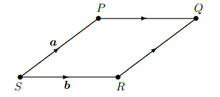

Question: Consider a rhombus PQRS
What is a rhombus?
If we let $a=\overset{⃑}{SP} and b=\overset{⃑}{SR}$,
Does $a=b$?
Does $||a||=||b||$?
Express the following in terms of $a$ and $b$
$\overset{⃑}{PR}$
$\overset{⃑}{QS}$

Slide 16
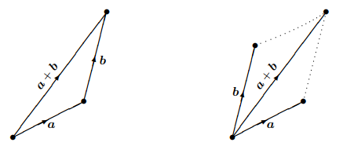
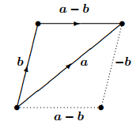

Vector operations
Sum of 2 vectors $a+b = b+a$
If $g = \left\langle 3, −9, 2 \right\rangle$ and $h = \left\langle 2, −10, −2 \right\rangle$
$g + h =$
$h + g =$
What happens if $z= <0,0,0>?$
$g + z =$
$g − z =$
$z – h =$

Slide 17
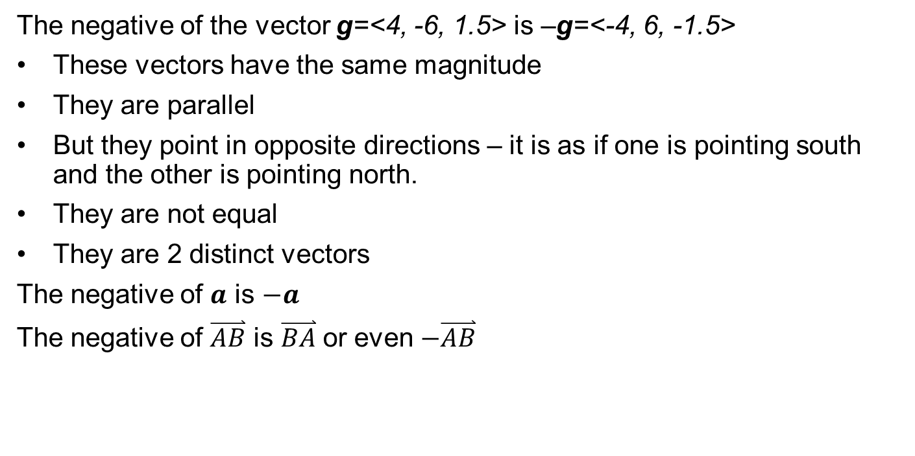
Negative of a vector
The negative of the vector g=<4, -6, 1.5> is –g=<-4, 6, -1.5>
These vectors have the same magnitude
They are parallel
But they point in opposite directions – it is as if one is pointing south and the other is pointing north.
They are not equal
They are 2 distinct vectors
The negative of $a$ is $−a$
The negative of $\overset{⃑}{AB}$ is $\overset{⃑}{BA}$ or even $−\overset{⃑}{AB}$

Slide 18
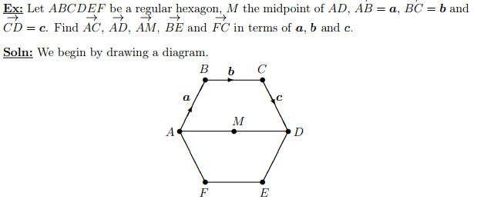
Let ABCDEF be a regular hexagon….

Slide 19
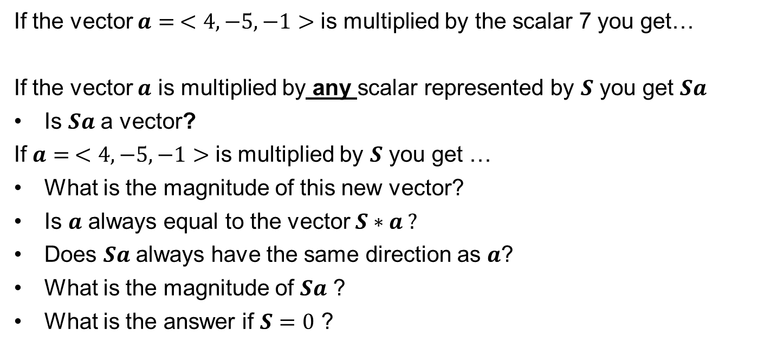
Scalar Multiplication
What happens when you multiply a vector by a scalar?
If the vector $a= <4, −5, −1>$ is multiplied by the scalar 7 you get…
If the vector $a$ is multiplied by any scalar represented by $S$ you get $Sa$
Is $Sa$ a vector?
If $a= <4, −5, −1>$ is multiplied by $S$ you get …
What is the magnitude of this new vector?
Is $a$ always equal to the vector $S∗a ?$
Does $Sa$ always have the same direction as $a$?
What is the magnitude of $Sa$ ?
What is the answer if $S=0$ ?

Slide 20
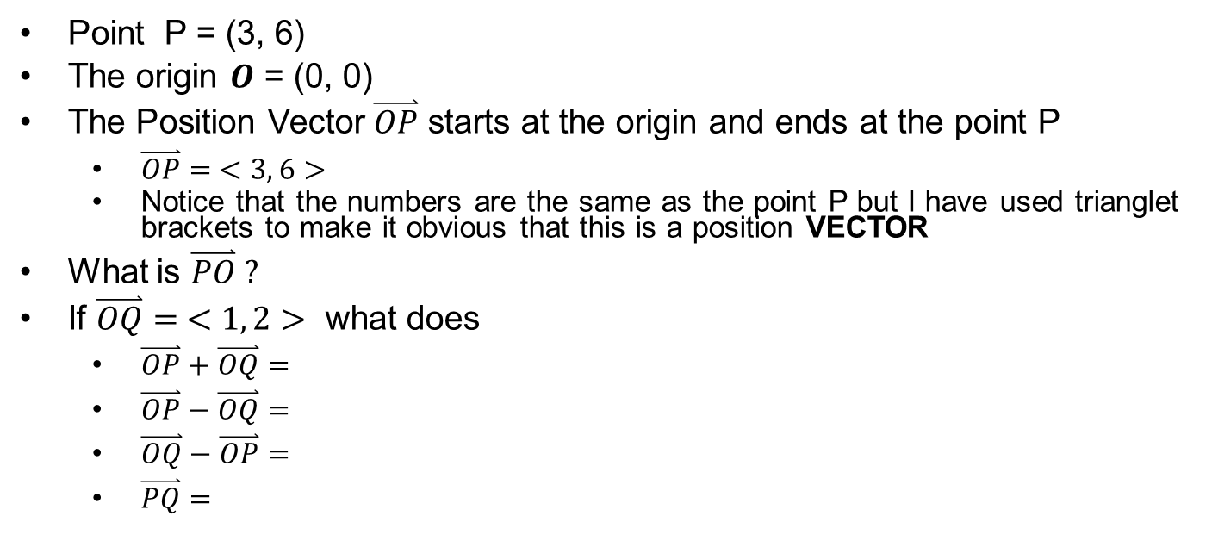
Position Vectors again
Points have no direction. A position vector tells you where a point is with reference to the origin
Point P = (3, 6)
The origin $O$ = (0, 0)
The Position Vector $\overset{⃑}{OP}$ starts at the origin and ends at the point P
$\overset{⃑}{OP}= <3, 6>$
Notice that the numbers are the same as the point P but I have used trianglet brackets to make it obvious that this is a position VECTOR
What is $\overset{⃑}{PO} ?$
If $\overset{⃑}{OQ}= <1, 2>$ what does
$\overset{⃑}{OP}+\overset{⃑}{OQ}=$
$\overset{⃑}{OP}−\overset{⃑}{OQ}=$
$\overset{⃑}{OQ}−\overset{⃑}{OP}=$
$\overset{⃑}{PQ}=$

Slide 21

Adding position vectors $\overset{⃑}{AB}= \overset{⃑}{OB}− \overset{⃑}{OA}$
Remember that $\overset{⃑}{AB}$ is the vector that goes from point A to point B
If A(-1, 2, 3), B(3, -1, 0), find
$\overset{⃑}{OA}$
$\overset{⃑}{OB}$
$\overset{⃑}{BA}$
$\overset{⃑}{AB}$
What space are these vectors in?
Does $\overset{⃑}{AB}$ = $\overset{⃑}{BA} ?$

Slide 22
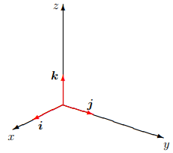
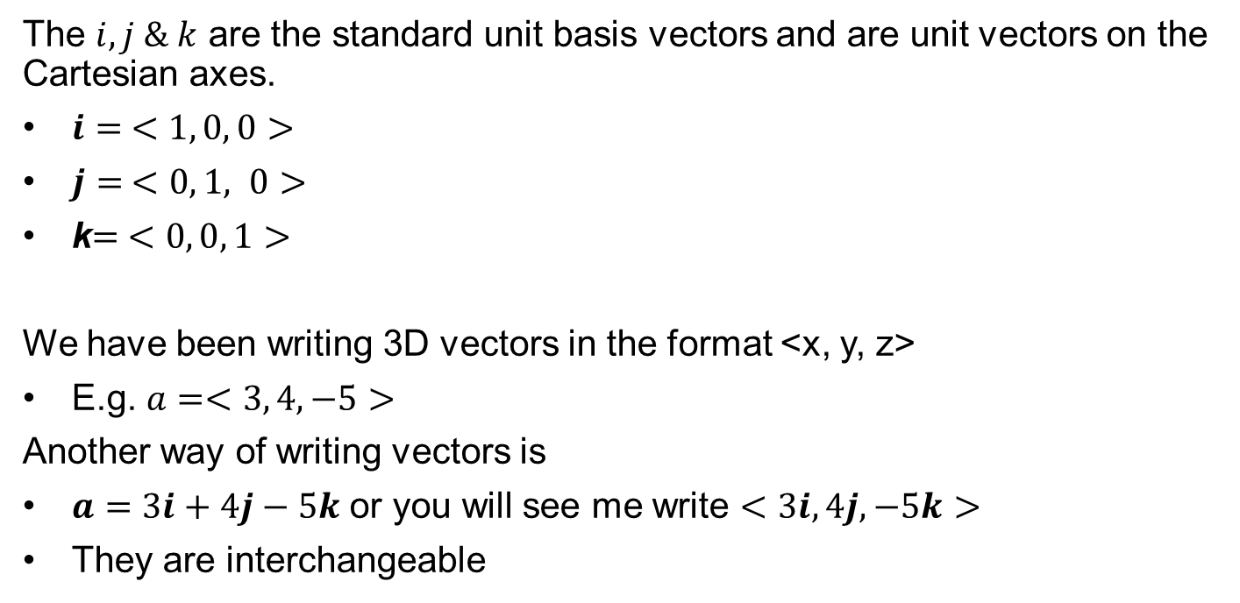
Standard Unit Basis Vectors
Big words for something simple
The $i, j \& k$ are the standard unit basis vectors and are unit vectors on the Cartesian axes.
$i= <1, 0, 0>$
$j= <0, 1, 0>$
k$= <0, 0, 1>$
We have been writing 3D vectors in the format <x, y, z>
E.g. $a=<3, 4, −5>$
Another way of writing vectors is
$a=3i+4j−5k$ or you will see me write $<3i, 4j, −5k>$
They are interchangeable

Slide 23

ProbleM
If $a=3i−j+2k$ and $b=<5, −2, −1>$ …
Calculate:
$a+b$
$b−a$
$2a$
$2a+b$
$|a|$
$|\left|a+b\right||$

Slide 24
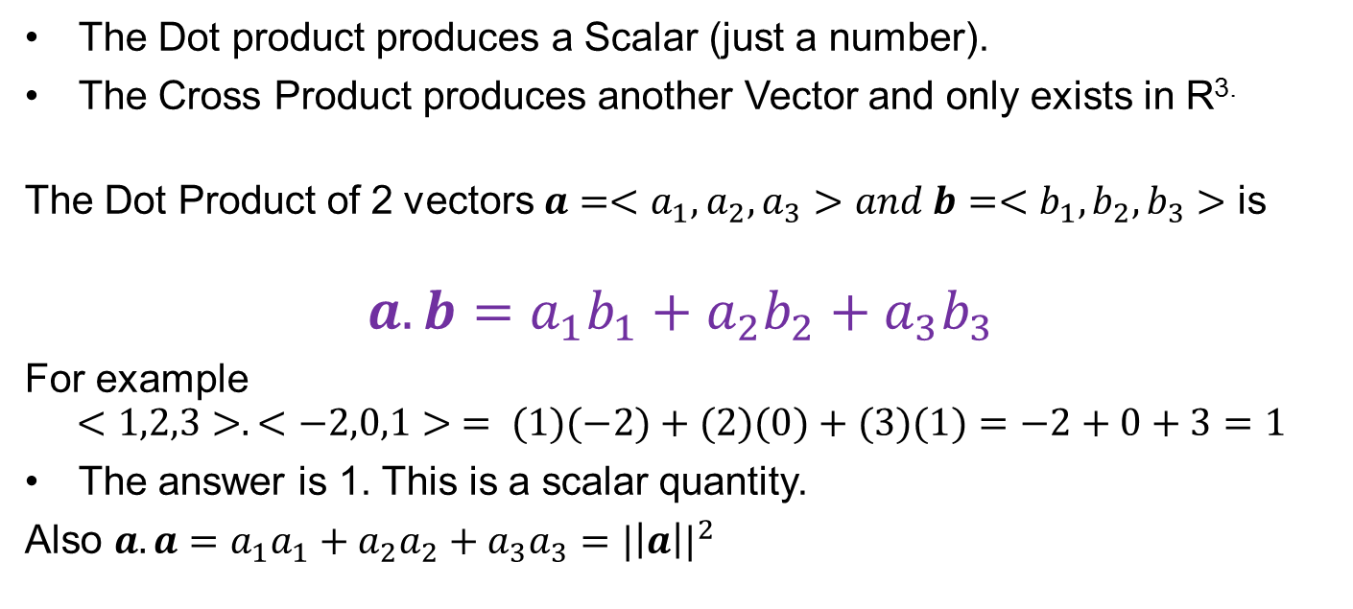
The dot product (or scalar product)
There are 2 ways to multiply vectors the Dot Product and the Cross Product
The Dot product produces a Scalar (just a number).
The Cross Product produces another Vector and only exists in R^{3.}
The Dot Product of 2 vectors $a=<a_{1},a_{2},a_{3}>and b=<b_{1},b_{2},b_{3}>$ is
$$a.b=a_{1}b_{1}+a_{2}b_{2}+a_{3}b_{3}$$
For example
$$<1,2,3>.<−2,0,1> = (1)(−2)+(2)(0)+(3)(1)=−2+0+3=1$$
The answer is 1. This is a scalar quantity.
Also $a.a=a_{1}a_{1}+a_{2}a_{2}+a_{3}a_{3}={|\left|a\right||}^{2}$

Slide 25
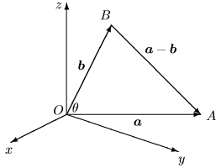
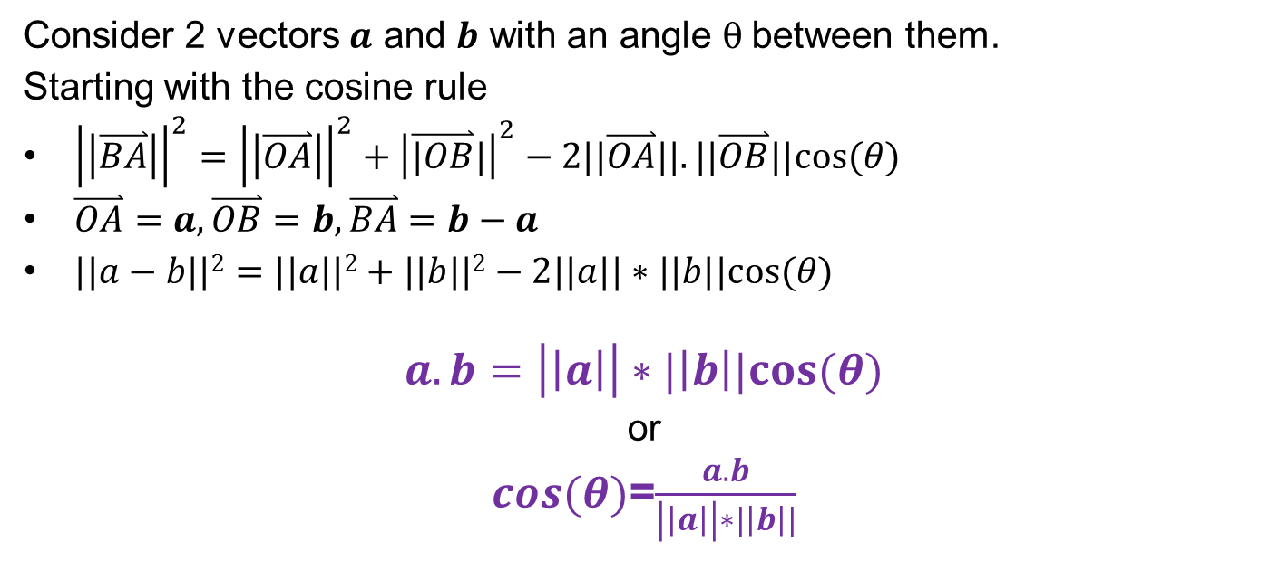
Dot product rule
The Dot Product Rule has a geometric meaning
Consider 2 vectors $a$ and $b$ with an angle q between them.
Starting with the cosine rule
${\left|\left|\overset{⃑}{BA}\right|\right|}^{2}={\left|\left|\overset{⃑}{OA}\right|\right|}^{2}+{\left|\overset{⃑}{|OB}|\right|}^{2}−2||\overset{⃑}{OA}||.||\overset{⃑}{OB}||cos⁡(θ)$
$\overset{⃑}{OA}=a, \overset{⃑}{OB}=b, \overset{⃑}{BA}=b−a$
$||a−b||2=||a||2+||b||2−2||a||∗||b||cos⁡(θ)$
$$a.b=\left|\left|a\right|\right|∗|\left|b\right||cos⁡(θ)$$
or
$cos(θ)$=$\frac{a.b}{\left|\left|a\right|\right|∗|\left|b\right||}$

Slide 26
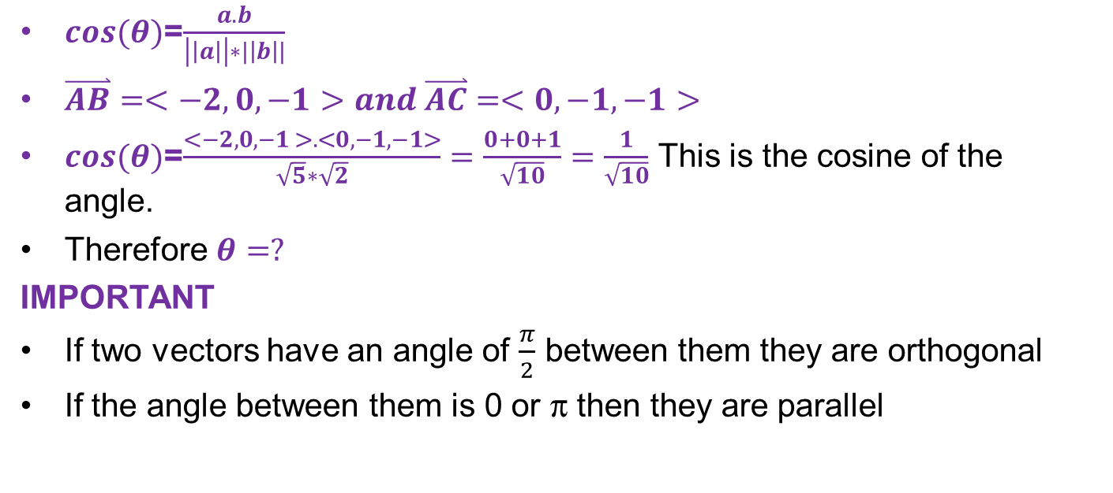
Find the angle BAC
If the points are defined as A(1,0,2), B(-1,0,1) and C(1,-1,1)
$cos(θ)$=
$cos(θ)$=$\frac{<−2,0,−1 >.<0,−1,−1>}{\sqrt{5}∗\sqrt{2}}=\frac{0+0+1}{\sqrt{10}}=\frac{1}{\sqrt{10}}$ This is the cosine of the angle.
Therefore $θ=?$
IMPORTANT
If two vectors have an angle of $\frac{π}{2}$ between them they are orthogonal
If the angle between them is 0 or p then they are parallel

Slide 27
Show that the diagonals of a rhombus are perpendicular
What special properties does a rhombus have?
What formulae do I need to use to see if 2 vectors are perpendicular?
What does it have to equal?
Draw and label a rhombus

Slide 28
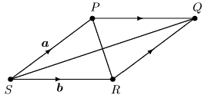

Slide 29
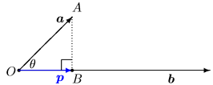

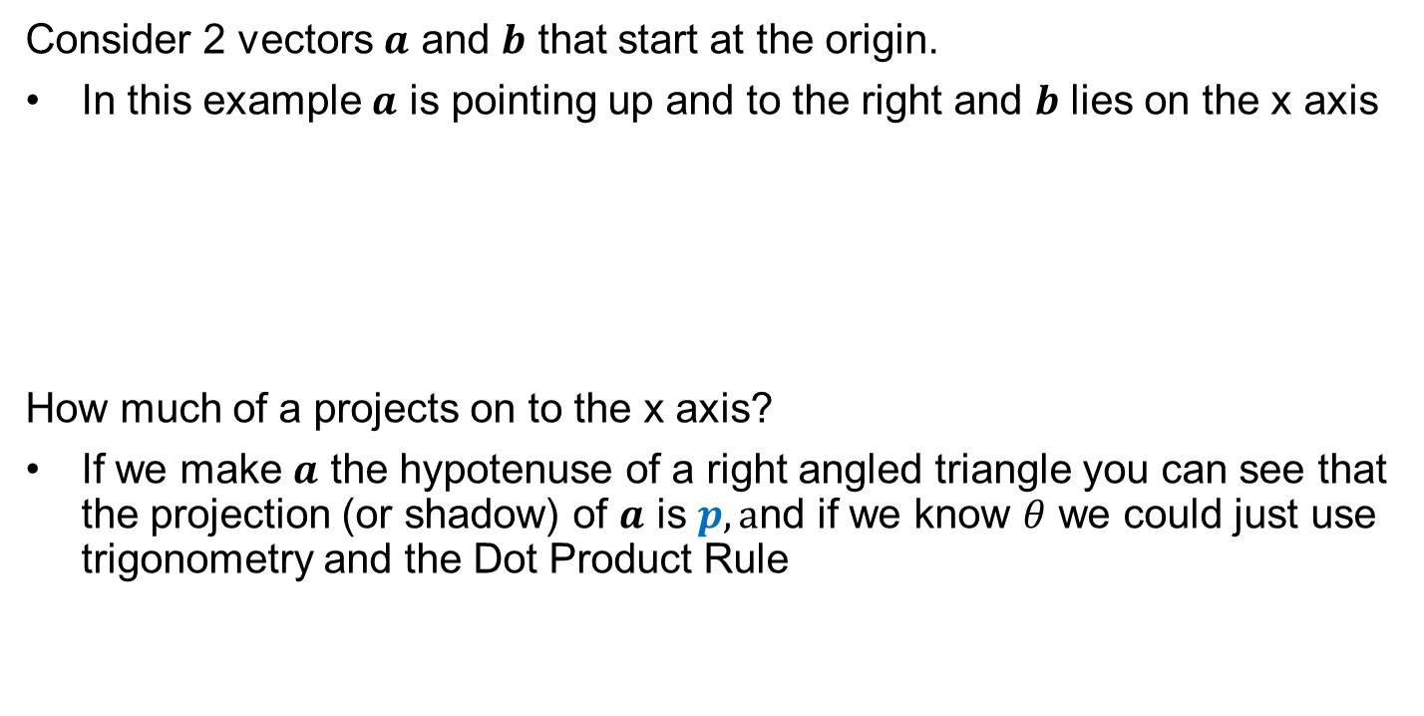
Projection & Component of a vector
Consider 2 vectors $a$ and $b$ that start at the origin.
In this example $a$ is pointing up and to the right and $b$ lies on the x axis
How much of a projects on to the x axis?
If we make $a$ the hypotenuse of a right angled triangle you can see that the projection (or shadow) of $a$ is $p, a$nd if we know $θ$ we could just use trigonometry and the Dot Product Rule

Slide 30
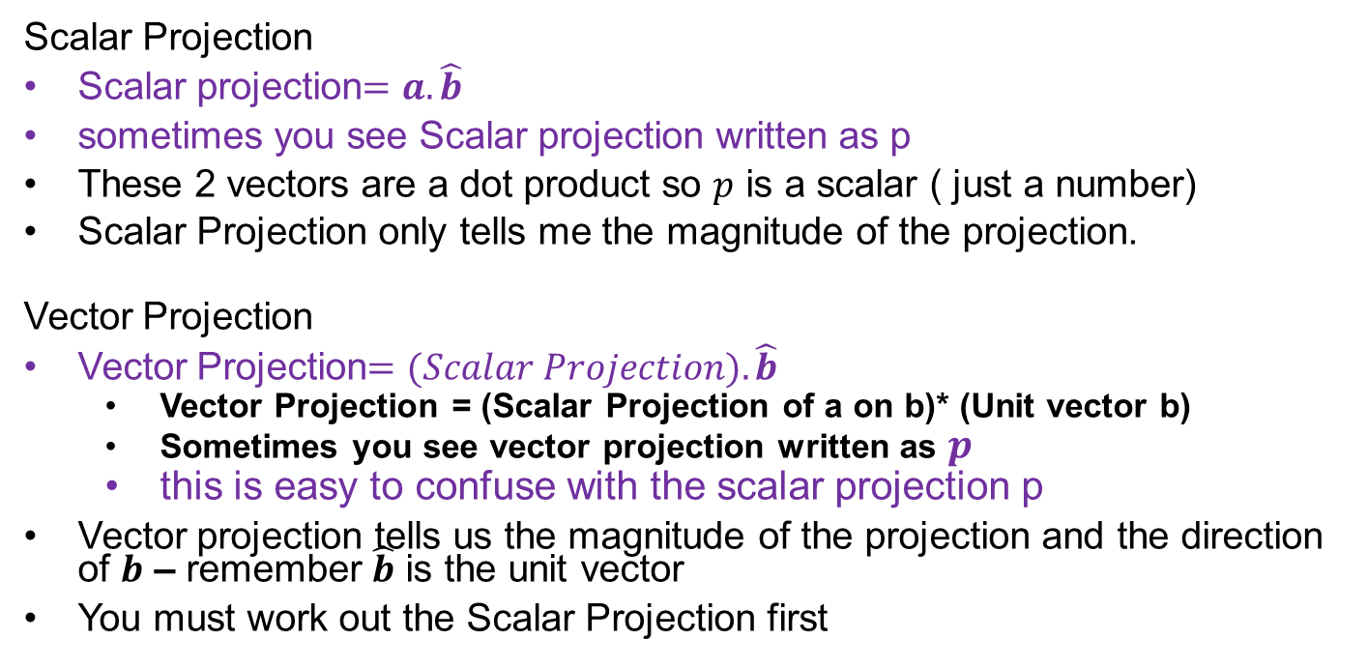
Scalar & Vector Projection
Scalar Projection
Scalar projection$=a.\hat{b}$
sometimes you see Scalar projection written as p
These 2 vectors are a dot product so $p$ is a scalar ( just a number)
Scalar Projection only tells me the magnitude of the projection.
Vector Projection
Vector Projection$=(Scalar Projection).\hat{b}$
Vector Projection = (Scalar Projection of a on b)* (Unit vector b)
Sometimes you see vector projection written as $p$
this is easy to confuse with the scalar projection p
Vector projection tells us the magnitude of the projection and the direction of $b$ – remember $\hat{b}$ is the unit vector
You must work out the Scalar Projection first

Slide 31
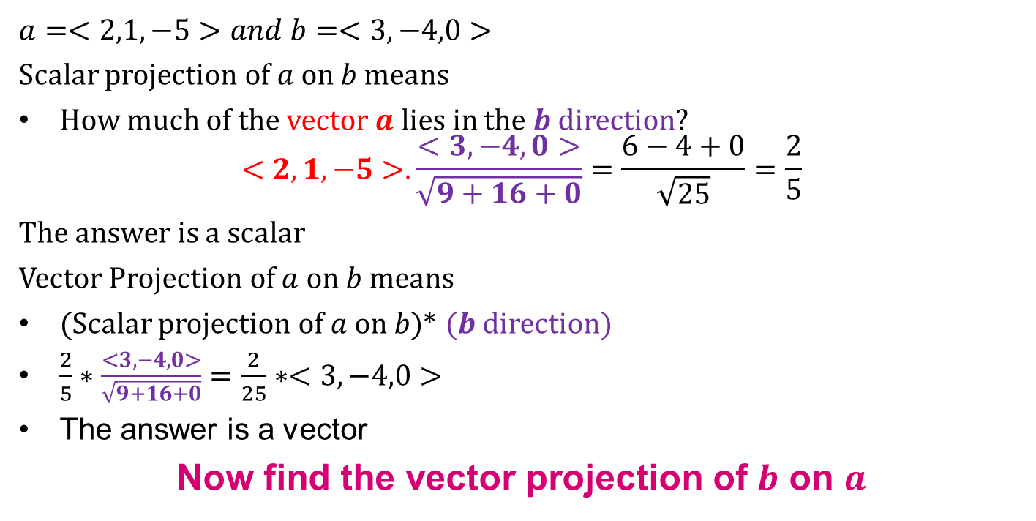
Problem
Find the scalar and vector projection of $a$ on $b$
$$a=<2,1,−5>and b=<3,−4,0>$$
Scalar projection of $a$ on $b$ means
How much of the vector $a$ lies in the $b$ direction?
$$<2,1,−5>.\frac{<3,−4,0>}{\sqrt{9+16+0}}=\frac{6−4+0}{\sqrt{25}}=\frac{2}{5}$$
The answer is a scalar
Vector Projection of $a$ on $b$ means
(Scalar projection of $a$ on $b$)* $(b$ direction)
$\frac{2}{5}∗\frac{<3,−4,0>}{\sqrt{9+16+0}}=\frac{2}{25}∗<3,−4,0>$
The answer is a vector
Now find the vector projection of $b$ on $a$

Slide 32
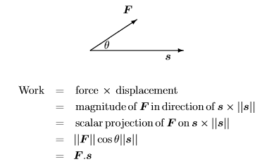

Work done by a force
A powerful application of Scalar Projection is when you ask how much work is done by a force $F$ when it results in a displacement $s$
$$Work=F.s$$
The Work Done is the Dot Product of the Force and the displacement

Slide 33

Problem
How much work is done by a force $F=<2,−3,−1>$ in moving an object from A(2,-1,3) to B(5,3,-6) ?

Slide 34
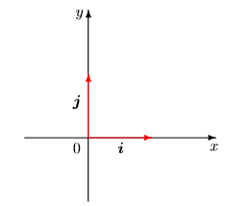
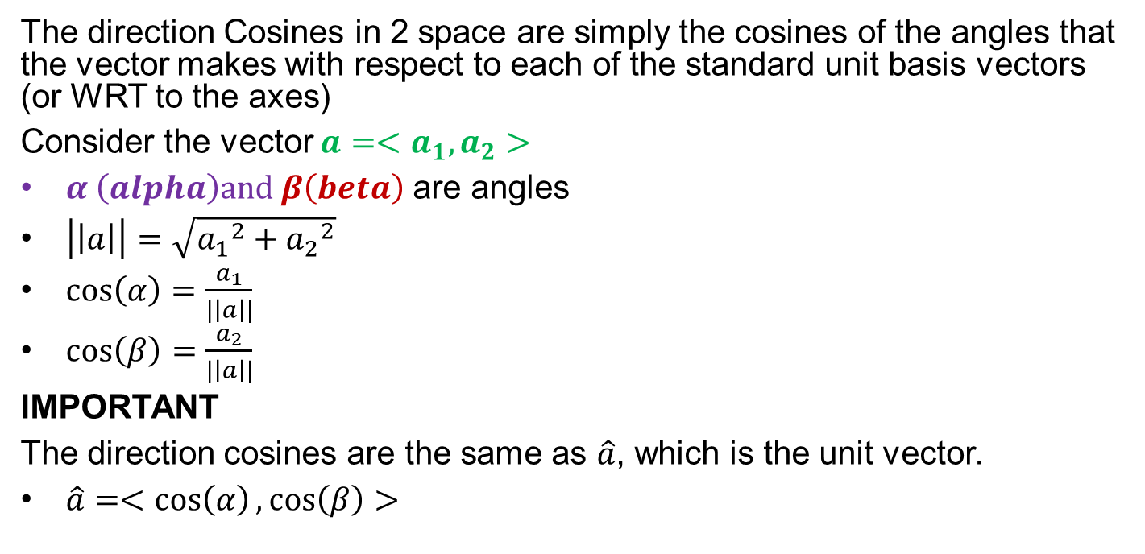


Direction Cosines in 2 space
The direction Cosines in 2 space are simply the cosines of the angles that the vector makes with respect to each of the standard unit basis vectors (or WRT to the axes)
Consider the vector $a=<a_{1},a_{2}>$
$α \left(alpha\right)and β\left(beta\right)$ are angles
$\left|\left|a\right|\right|=\sqrt{{a_{1}}^{2}+{a_{2}}^{2}}$
$\cos\left(α\right)=\frac{a_{1}}{|\left|a\right||}$
$\cos\left(β\right)=\frac{a_{2}}{|\left|a\right||}$
IMPORTANT
The direction cosines are the same as $\hat{a}$, which is the unit vector.
$\hat{a}=<\cos\left(α\right),\cos\left(β\right)>$
$$β$$
$$α$$

Slide 35
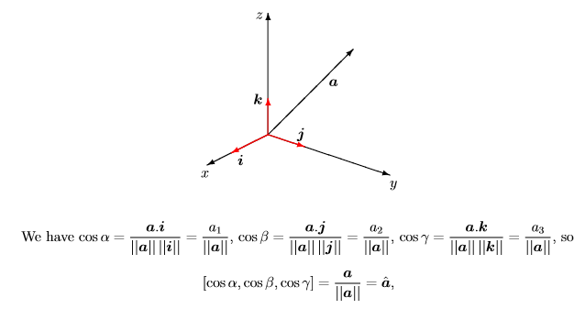
Direction cosines in 3 space

Slide 36
problem
Calculate the Direction Cosines for $c=<4,−5,3>$

